Slide 1
Startup Valuation and entrepreneurship ecosystem
Serik Seidigalimov

Slide 2
Content
What is a startup and its difference from established businesses?
The major problems of startups
Traditional solutions of valuation in business
Why those solutions are weak?
Real options approach
Conclusion

Slide 3


What is a startup?
Startups are innovative enterprises that bring new, novel products to the market.

Slide 4

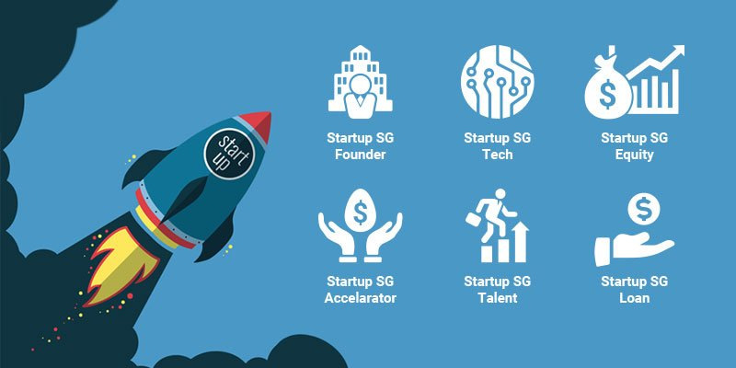


Startups vs. Established Businesses
Risk
Hotels
Innovative
Difficult to value
Financial history
Restaurants
Startups
Big impact on society
New business model
Car services

Slide 5

Major problems
Will it be successful or not?
What is the market size?
Who are our competitors?
How many people need it?
Who will invest?
Who much to invest?
Are our ideas are clear enough?
What is the financial value?

Slide 6


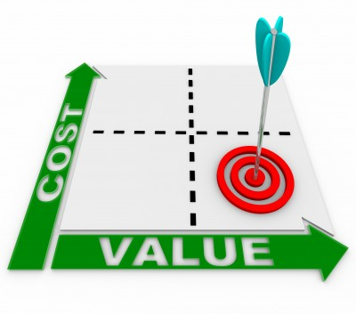
Traditional ways to value a company
the future potential profit or free cash flow generating potential of the asset and attempts to quantify,
assets in the marketplace and their corresponding prices
the cost a firm would incur if it were to replace or reproduce the asset’s future profitability
Income approach
Market approach
Cost approach

Slide 7

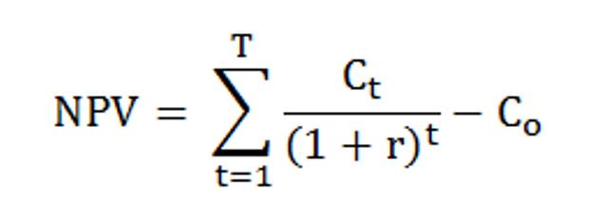
Discounted Cash Flow (DCF)
IF NPV is negative, then the project is weak and it will bring money
IF NPV is positive, then the project is successful

Slide 8
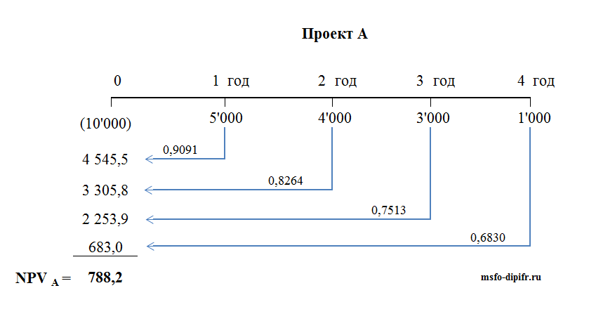
What problems DCF approach faces?
Assume all-or-nothing strategy
do not account for managerial flexibility
Less insights

Slide 9
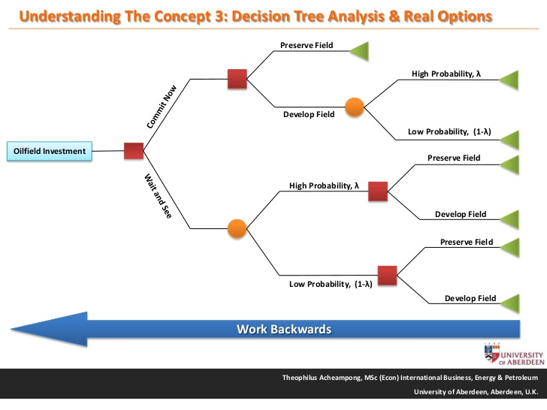
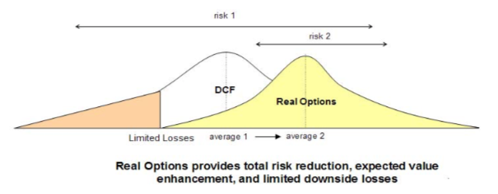
How it could be fixed?
Real options Valuation (ROV)
ROV does not replace DCF
It makes it more flexible and less risky

Slide 10
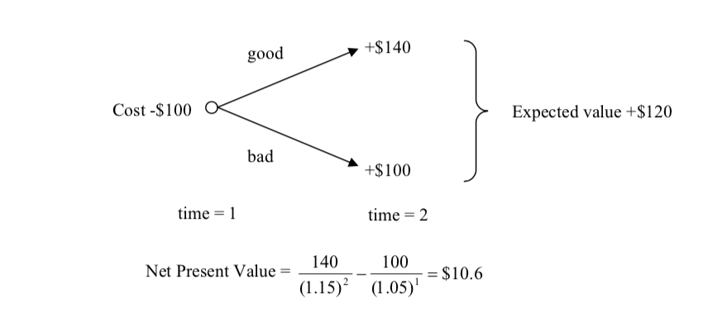
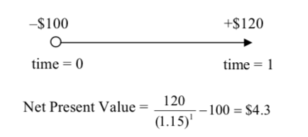
Real options Valuation
Let’s consider example
OR
Wait 1 year, make research and analysis, and then make decision
Invest all money at t=0

Slide 11




ROV and Startups
How much of money for how much of equity:
Valuation???
Startup Team with
owner
Investor
Become a partner and own equity
Invest money
Ideas
Money

Slide 12
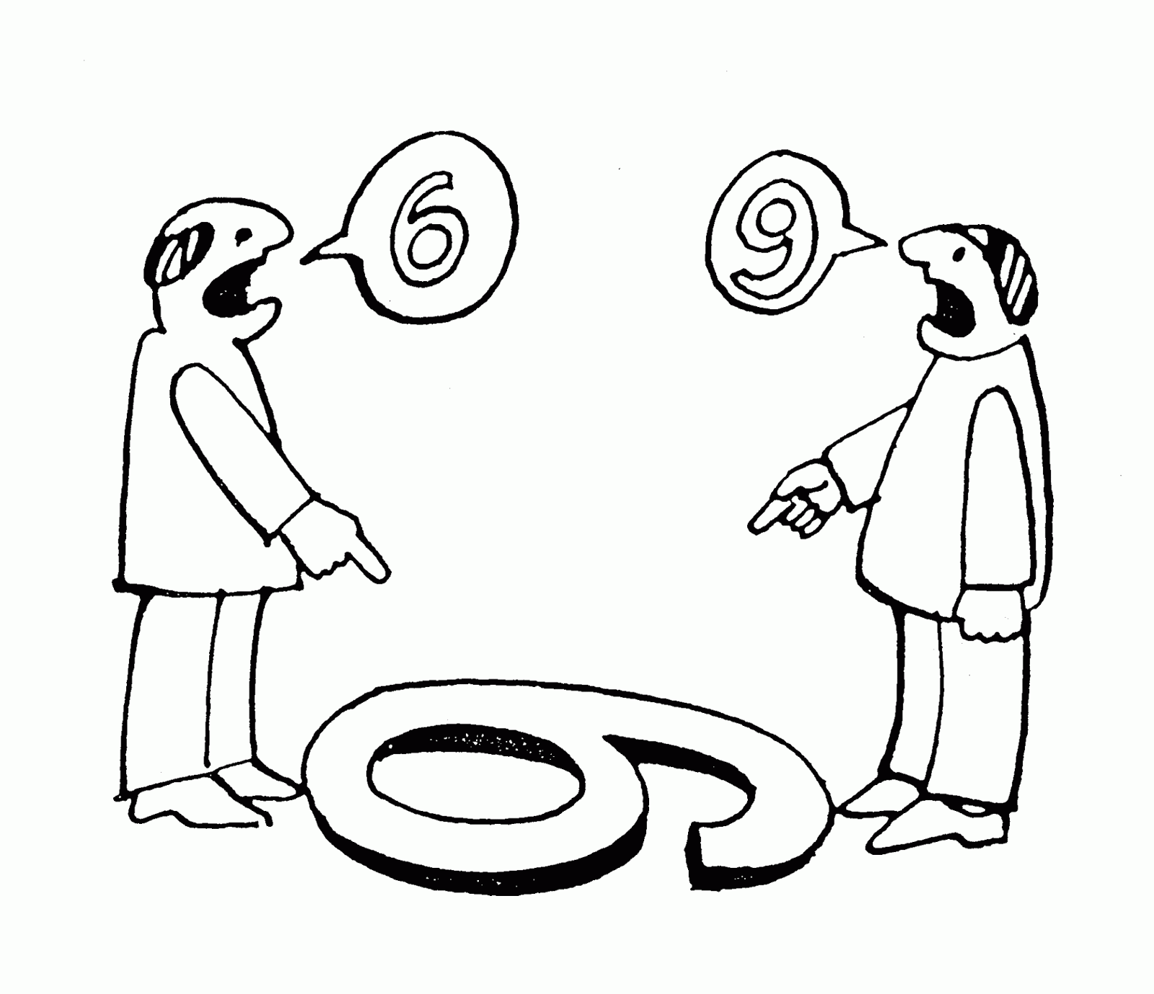
Solution
They need to talk on the same language:
Reflect all numbers into spreadsheet with analysis and run simulations
Negotiation
BUT
Use real options to value the startup, and then they can answer to the previous question
Therefore…

Slide 13
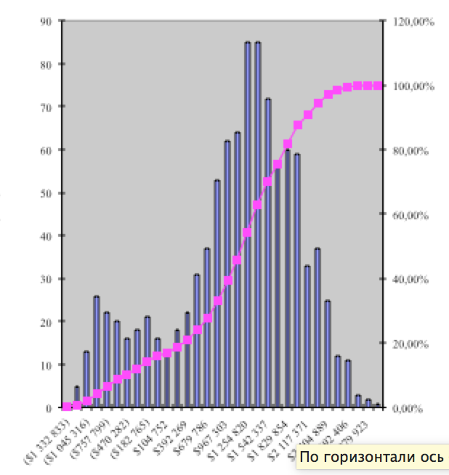


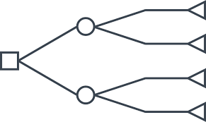
Calculate the probabilities using Monte Carlo simulation
Estimate future incomes
Put into decision tree

Slide 14


Interconnect startup owners with investors, so that they will have the same knowledge
Mobile app

Slide 15
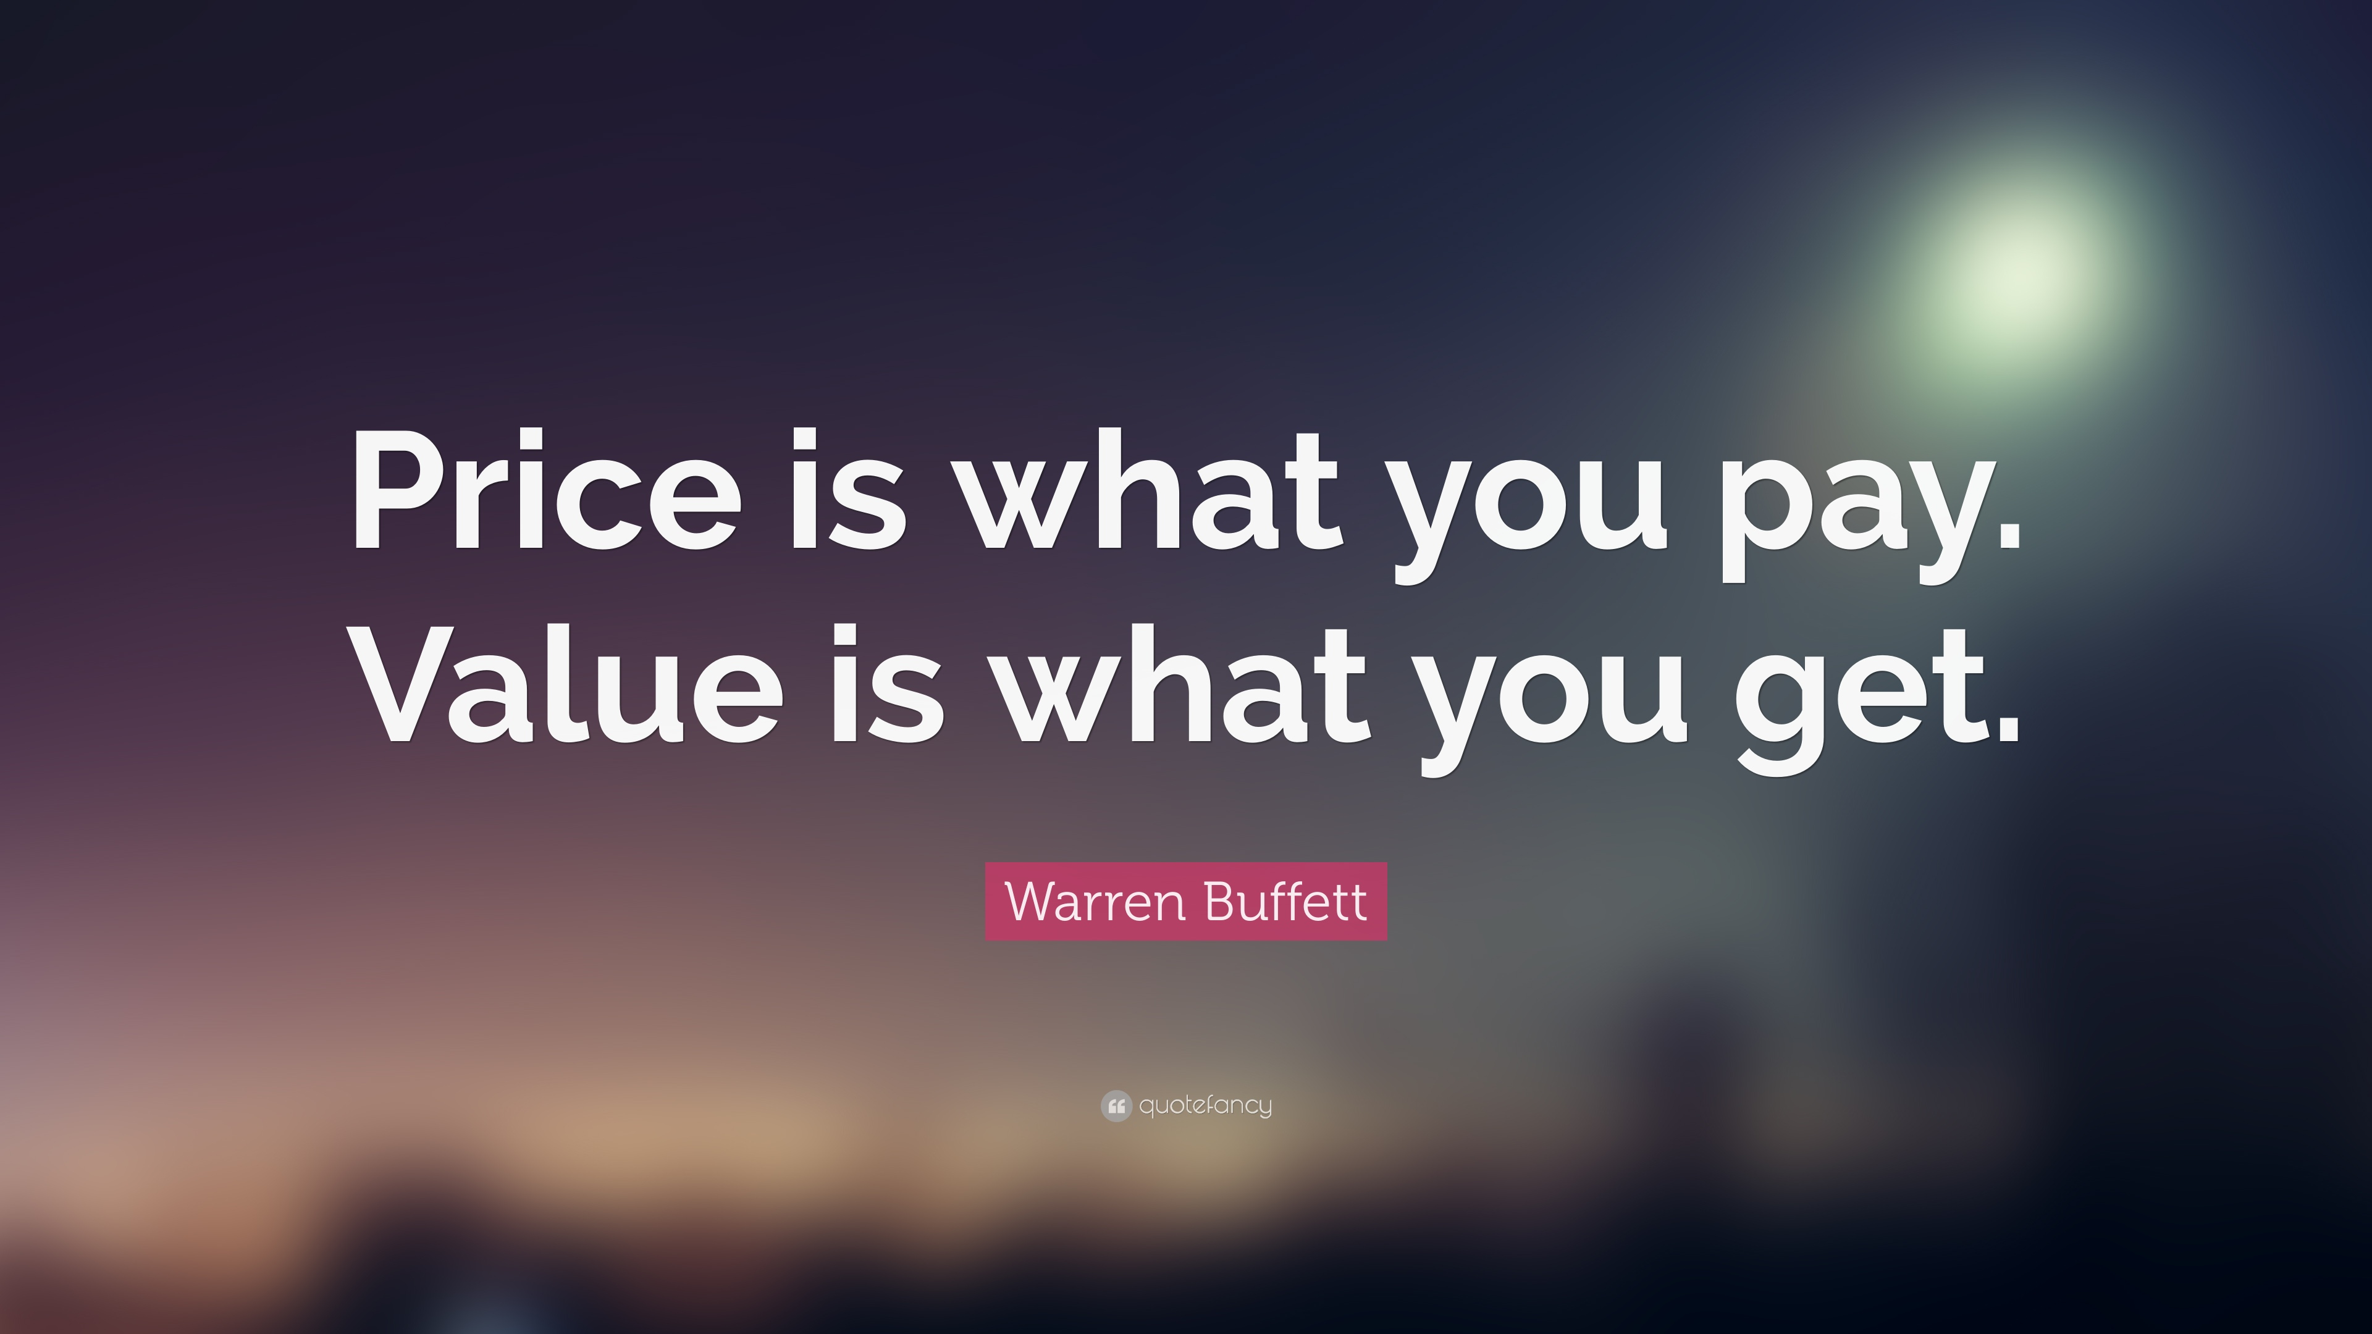

Slide 16
Thanks for your attention!

